Slide 1
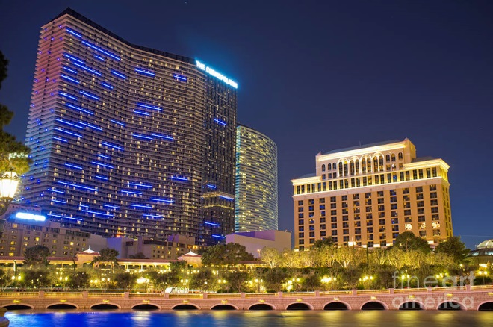
2013 Annual Meeting
Welcome to Las Vegas!

Slide 2
2013 Annual Meeting
Secretary/Treasurer’s Report
--------
Anti-Trust Guidelines Review
-------
Steering Committee Members & Ballot
April 16, 2013
Nick Freitag, Secretary/Treasurer
treasurer@easistandards.com

Slide 4
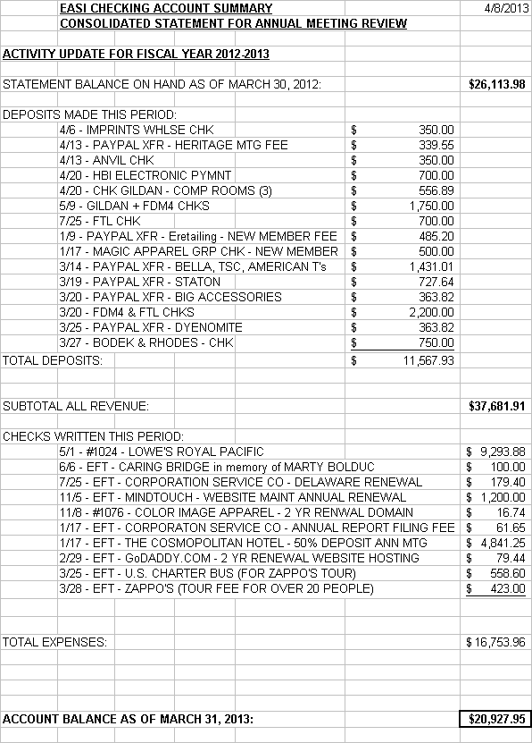
Annual Financial Report

Slide 5
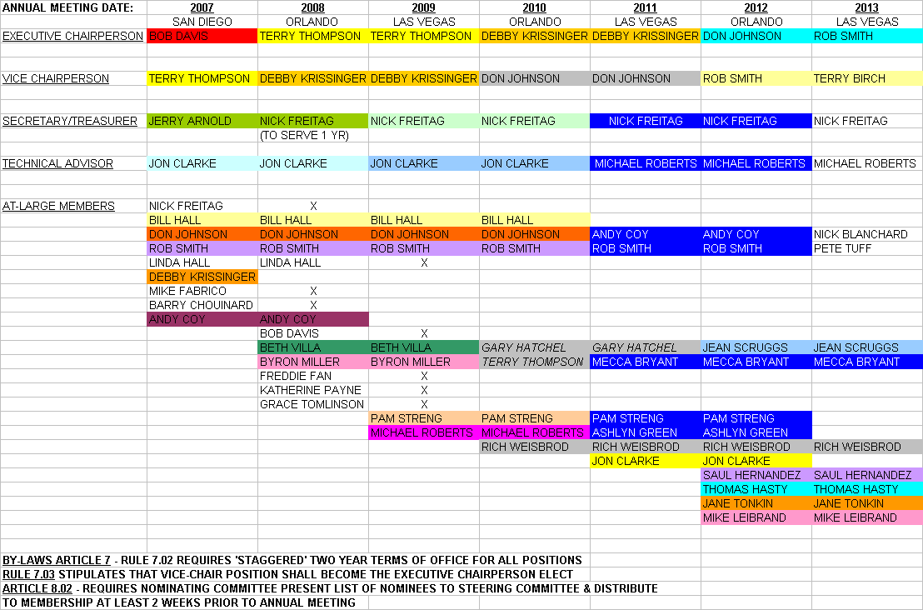
Steering Committee Members

Slide 6
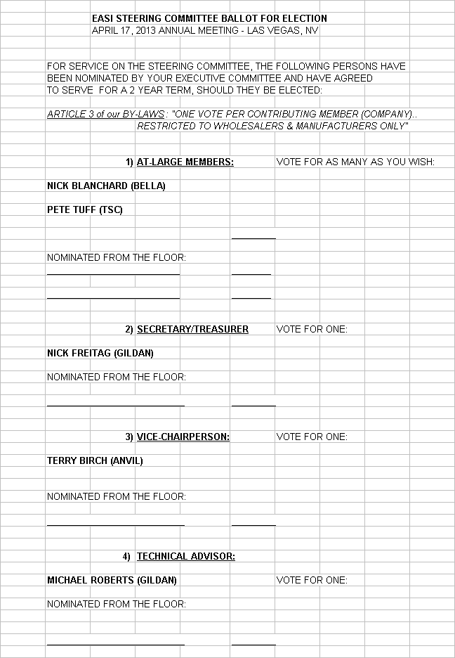
Today’s Ballot:

